Slide 1


STI-2024
$6^{th}$ INTERNATIONAL CONFERENCE ON SUSTAINABLE TECHNOLOGIES
FOR INDUSTRY 5.0
Presenter-
Prof. Dr. Md. Saiful Azad
Organizing Chair, STI-2024

Slide 2
Content
01
Sustainable Technology
02
Industry 5.0
03
Sustainable Technology for Industry
04
Benefits of Participating
05
Details of Earlier Iterations
06
Keynote Speakers of Earlier Iterations
07
STI Dates & Schedules

Slide 3





Sustainable Technology
Meets the needs of present without compromising the ability of future generations to meet their own needs
Economy
Promoting sustainable economic growth ensures long-term prosperity and resilience.
Economy
Environment
Environment
Protecting our environment safeguards natural resources for future generations.
Sustainability
Equity
Ensuring social equity guarantees fair opportunities and access for all individuals.
Equity

Slide 4





Industry 5.0
Industry 5.0
Human-Robot collaboration, Customization and Cognitive System
Industry 5.0 is the next phase of industrial evolution, focusing on the integration of advanced technologies with a human-centric approach.
Key Components:
Human-Machine Collaboration
Personalization
Sustainable
Industry 4.0
Advances in Cyber-physical systems, IoT and network communications
Industry 3.0
Computers and electronics make automation possible
Industry 2.0
Assembly lines and electricity allows for mass production
Industry 1.0
Marked by Mechanization and powered by water and steam

Slide 5





STI-2024
An annual event that brings together researchers, industry experts, and academics to discuss and promote sustainable technologies in Industry 5.0.
Keynote and Invited Speeches
Workshop and Tutorials
Technical Paper Submission
Interactive Paper Session
Industrial Talks
High-level Panel Discussion on Industry 5.0

Slide 6

01
First conference in southeast Asia on Sustainable Technologies for Industry 4.0 and Industry 5.0
Why STI
Only conference in Bangladesh, which is technically sponsored by the central IEEE Computer Society
02
03
All the papers of our previous editions are included in the IEEE xplore digital library within short period of times
From the very first edition, all the accepted papers are included in the Scopus and other renowned databases
04
05
In our last edition (STI 2023), Seven (7) academic and industry experts where one was IEEE fellow have joined us as keynote speakers

Slide 7
Benefits of Participating in STI-2024
Knowledge Enhancement
Access to Cutting-Edge Research
Workshops and Tutorials
Exposure and Visibility:
Publication Opportunities
Showcase Innovations
Networking Opportunities:
Meet Industry Leaders and Experts
Collaboration and Partnerships
Industry Insights:
Learn About Industry Trends
Influence Future Directions
Professional Development:
Presentation Opportunities
Recognition and Awards
Personal Growth:
Inspirational Keynotes
Global Perspective

Slide 8
Details of Earlier Iterations
Event | Number of submitted Papers | Technical Co-Sponsor | Website
STI-2019 | 1051 | IEEE Bangladesh Section | https://fse.green.edu.bd/sti-2019/
STI-2020 | 615 | IEEE Computer Society, IEEE Computer Society(Bangladesh Chapter) | https://fse.green.edu.bd/sti-2020/
STI-2021 | 187 | IEEE Advancing Technology for Humanity, IEEE Computer Society | https://fse.green.edu.bd/sti-2021/
STI-2022 | 179 | IEEE Advancing Technology for Humanity, IEEE Computer Society | https://fse.green.edu.bd/sti-2022/
STI-2023 | 11 | IEEE Advancing Technology for Humanity, IEEE Computer Society | https://sti.green.edu.bd/2023/

Slide 9
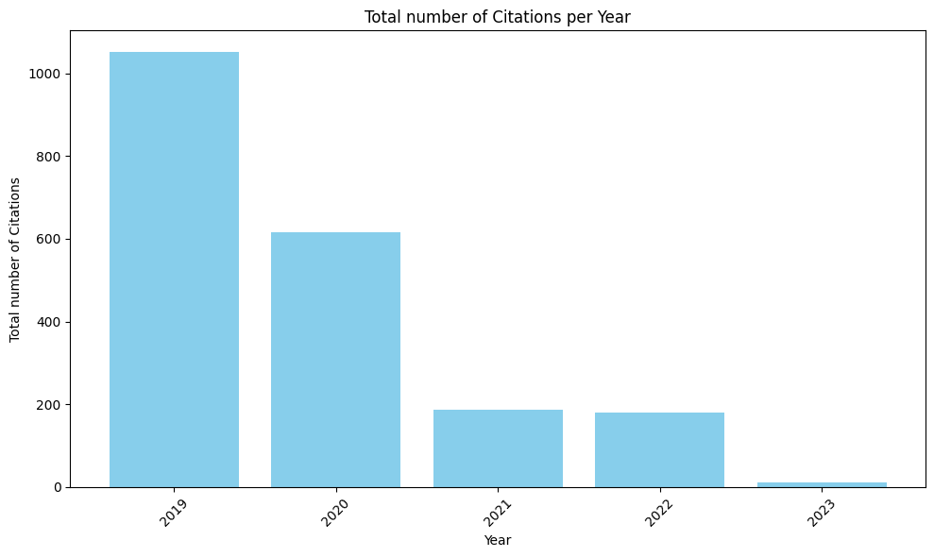
SL. | Year | Total number of Citations
1 | 2019 | 1051
2 | 2020 | 615
3 | 2021 | 187
4 | 2022 | 179
5 | 2023 | 11

Slide 10
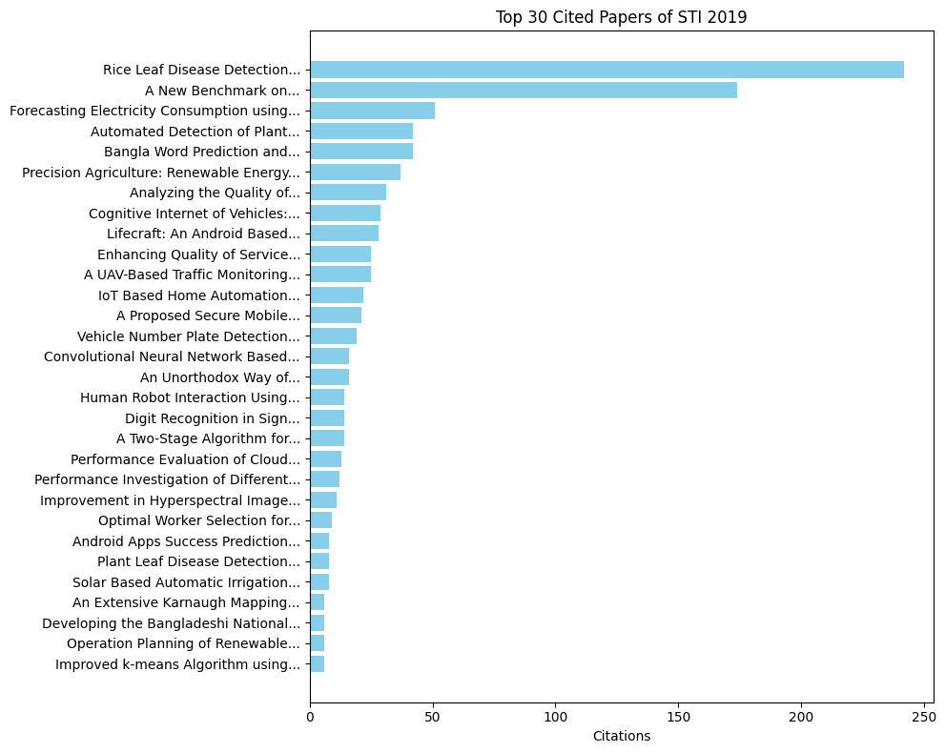

Slide 11
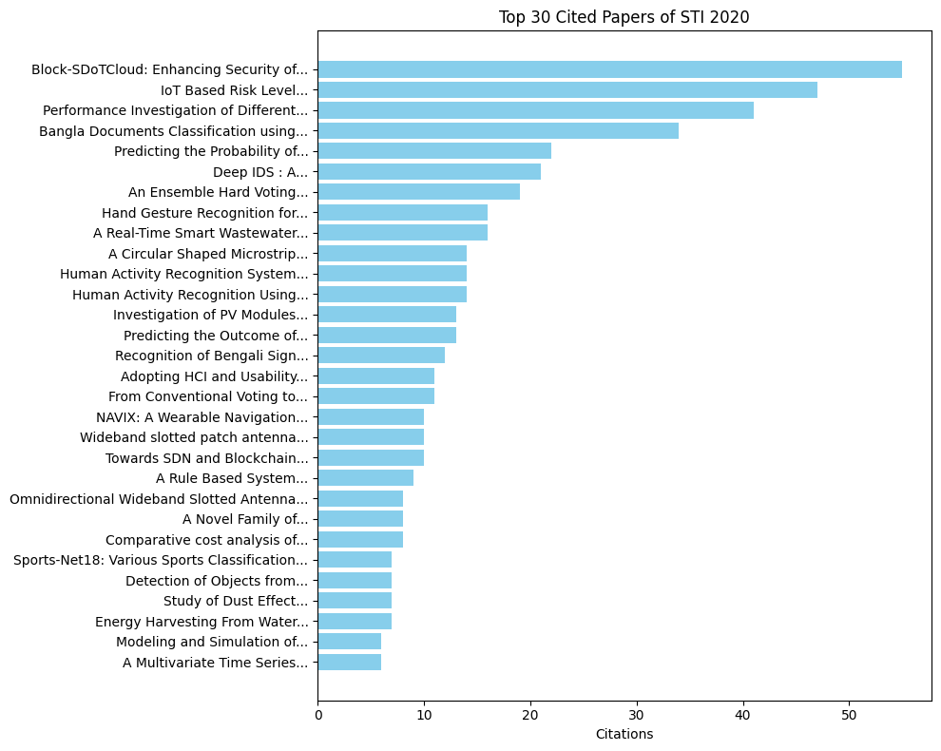

Slide 12
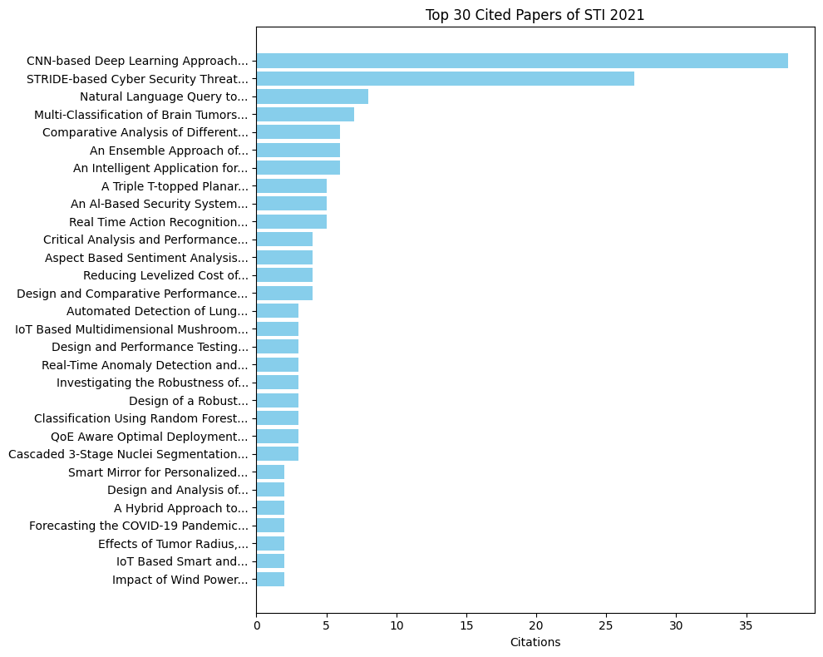

Slide 13
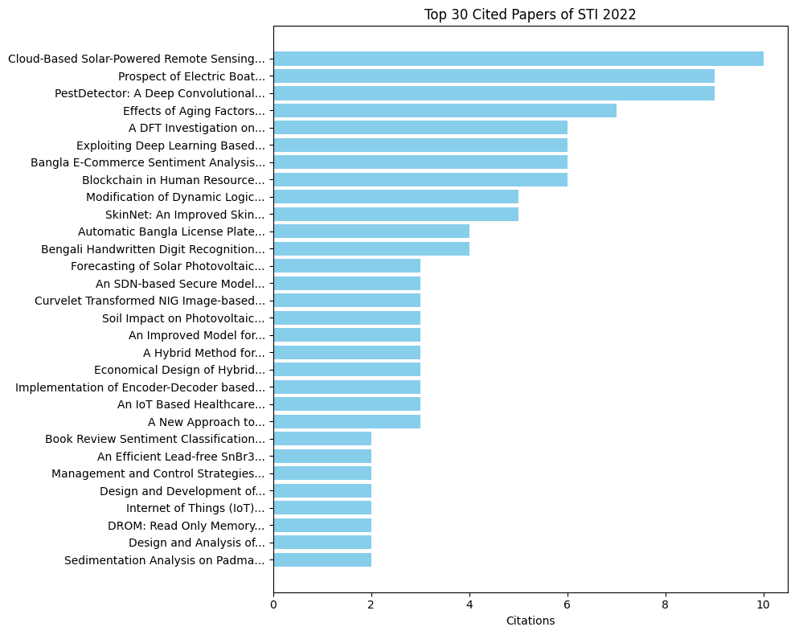

Slide 14
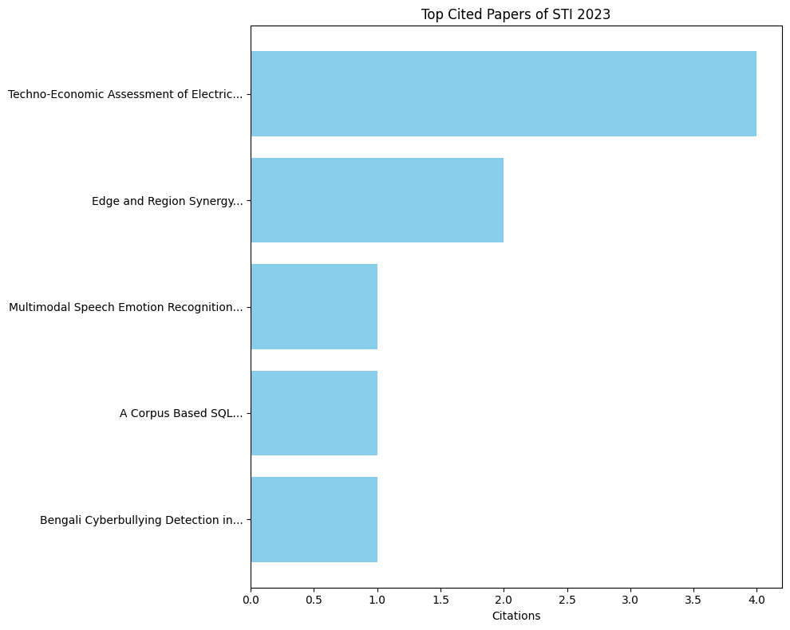

Slide 15
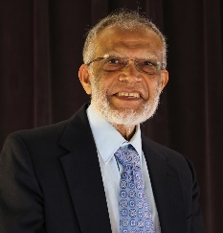
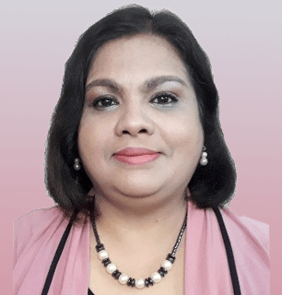
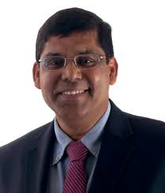
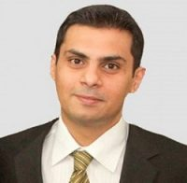
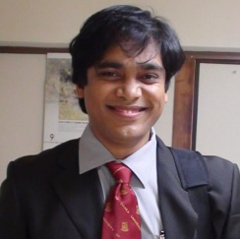
Keynote Speakers of STI-2019
Muhammad H. Rashid (IEEE Fellow) Professor, Electrical Engineering, Florida Polytechnic University, USA
Celia Shahnaz(Chair, IEEE BDS) Professor, BUET
Sajal K. Das (IEEE Fellow) Missouri University of Science and Technology,
USA
Reduan Hasan Khan, PhD(Senior Member, IEEE) Head of IoT & ICT, Grameenphone Ltd
Md Atiqur Rahman Ahad(Senior Member,
IEEE) Osaka University, Japan

Slide 16
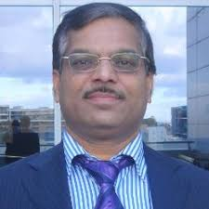
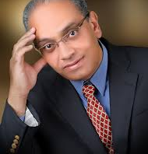
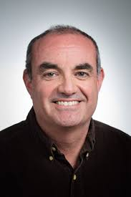
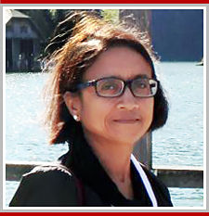
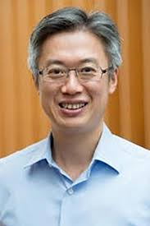
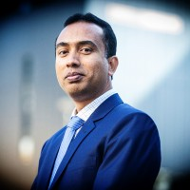
Keynote Speakers of STI-2020
Rajkumar Buyya (IEEE Fellow) University of Melbourne Australia
Hussein Abbass (IEEE Fellow) University of New South Wales, Australia
Claudio A. Canizares (IEEE Fellow) University of Waterloo, Canada
Sushmita Mitra (IEEE Fellow) Indian Statistical Institute, Kolkata
Vincent Wong (IEEE Fellow) University of British Columbia, Canada
Md. Rabiul Islam (Senior Member, IEEE) University of Wollongong, Australia

Slide 17
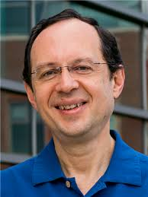
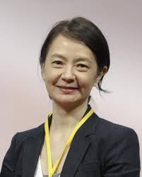
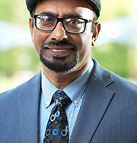
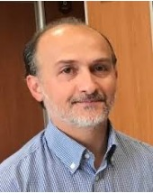
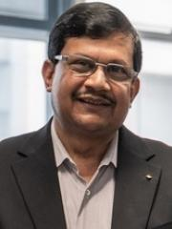
Keynote Speakers of STI-2021
Tarek Abdelzaher (IEEE Fellow) University of Illionois, Urbana Champaign, USA
Ai-Chun Pang (IEEE Fellow) National Taiwan University, Taiwan
Amit K. Gupta (IEEE IET IES) Head of Rols-Royce Electrical Singapore
M. Ashraful Alam (IEEE Fellow) Pudue University, USA
Giancarlo Fortino (IEEE Fellow) University of Calabria, Italy
Sajal K. Das (IEEE Fellow) Missouri University of Science and Technology,
USA
Hussein Abbass (IEEE Fellow) University of New South Wales, Australia
Tapan Saha (IEEE Fellow) University of Queensland, Australia

Slide 18
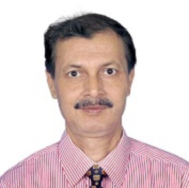
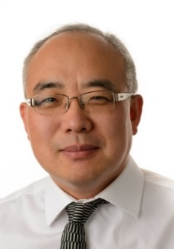
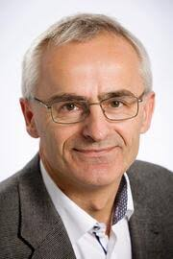
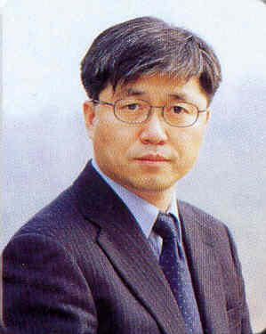
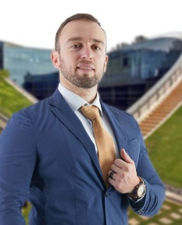
Keynote Speakers of STI-2022
Bidyut B. Chaudhuri (IEEE Life Fellow) Techno India University, Kolkata, India
Z. Y. Dong (IEEE Fellow) Nanyang Technological University, Singapore
Frede Blaabjerg (IEEE Fellow) Aalborg University, Denmark
Choong Seon Hong (Senior Member, IEEE) Kyung Hee University, South Korea
Erik Cambria (IEEE Fellow) Founder of SenticNet Lab, Nanyang Technological University, Singapore

Slide 19
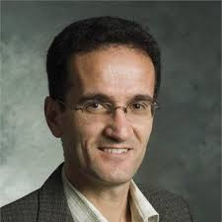
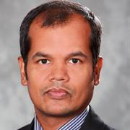

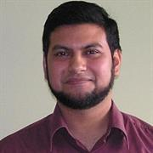
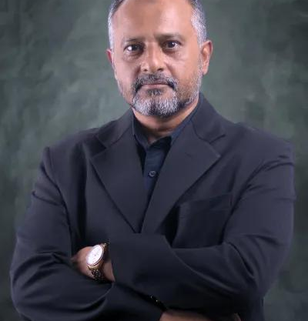
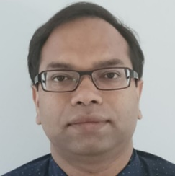
Keynote Speakers of STI-2023
Hassan Bevrani (IEEE Fellow) University of Kurdistan, Iran
Jahangir Hossain Professor University of Technology, Australia
Michael Rada President & Project Father IBCSD, Czech Republic
Abdun Mahmood Associate Professor La Trobe University, Melbourne, Australia
Mayeen Uddin Khandaker Professor Sunway University, Malaysia
Razib Islam Senior Manager Ooredoo, Qatar

Slide 20

Important Dates of STI-2024
31 July, 2024
Full Paper Submission
16 September, 2024
Submission of Special Session, Tutorial and Workshop Proposal
16 September, 2024
Proposal for Student Conference
15 October, 2024
Final Camera-Ready Paper Submission
30 October, 2024
Acceptance Notification
14-15 December, 2024
Conference Date

Slide 21
Common Conference Structure following previous STI
Day 1
Day 2
Registration and Welcome Coffee
Opening Ceremony
Keynote speeches
Technical Sessions
Lunch Break
Panel Discussions
Poster Sessions
Networking Reception
Workshops and Tutorials
Technical Sessions
Lunch Break
Invited Speaker Sessions
Special Sessions
Exhibitions and Demos
Closing Ceremony
Farewell Reception

Slide 22

Committees
Chief Patron
Mr. Mohammed Abdullah Al-Mamun, Chairman, BoT, Green University of Bangladesh
General Chair
Md. Abdur Razzaque, University of Dhaka
Patron
Mohammad Shorif Uddin, Vice Chancellor, Green University of Bangladesh
Organizing Chair
Md. Saiful Azad, Green University of Bangladesh
Co-Patron
Khawza Iftekhar Uddin Ahmed, Pro-Vice Chancellor, Green University of Bangladesh
General Co-Chairs
Nitai Chandra Sutradhar, Green University of Bangladesh
Md. Zahidul Islam, Islamic University

Slide 23


